Slide 1
Incident Impact Prediction
Presented by
Ankur Choudhury

Slide 2
Business Problem:
To predict the impact of the incident raised by the customer.
Objective:
To predict an impact on the basis of event log of an incident management process extracted from a service desk platform of an IT company.

Slide 3
Project Architecture:
Problem identification
Decide on a problem
Data identification
Acquire data
Clean data
Extract features
Pre-processing
Deal with missing data
Feature engineering
Generate models
Model
processing
Select final model
Evaluate final model
Application
Use model

Slide 4
Exploratory Data Analysis (EDA) and
Feature Engineering

Slide 5
Python Libraries Used:
Numpy
Pandas
Seaborn
Matplotlib
Sklearn
Imblearn
Streamlit
Pickle.

Slide 6
Data-Set Used:
incident_event_log.csv
Data details:
Number of rows | 36
Number of columns | 141712
Data types | Boolean:4 Integer64:3 Objects :29
Duplicates | 0
Therefor from the above there are 141712 rows and 36 columns are present in the give incident_event_log dataset.

Slide 7
Column Names:
1.number
2.incident_state
3.active
4.reassignment_count
5.reopen_count
6.sys_mod_count
7.made_sla
8.caller_id
9.opened_by
10.opened_at
11.sys_created_by
12.sys_created_at
13.sys_updated_by
14.sys_updated_at
15.contact_type
16.location
17.category
18.subcategory
19.u_symptom
20.cmdb_ci
21.impact
22.urgency
23.priority
24.assignment_group
25.assigned_to
26.knowledge
27.u_priority_confirmation
28.notify
29.problem_id
30.rfc
31.vendor
32.caused_by
33.closed_code
34.resolved_by
35.resolved_at
36.closed_at

Slide 8
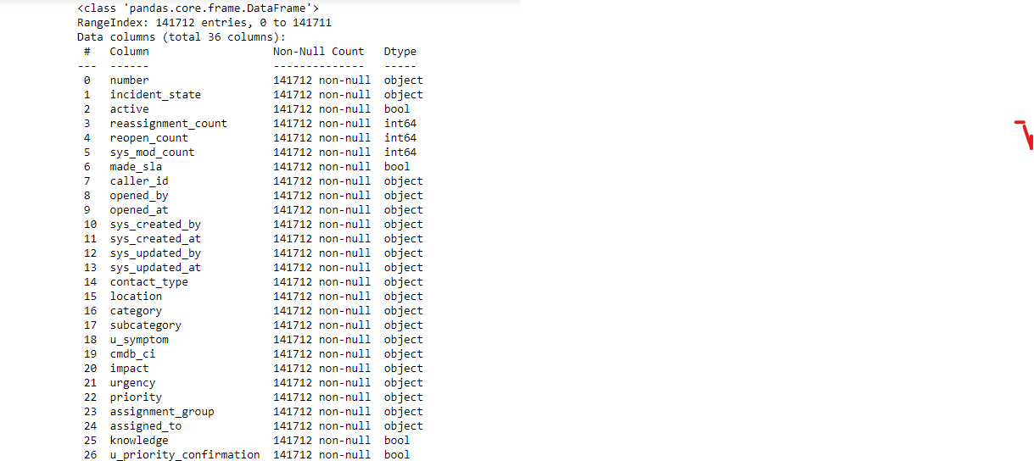
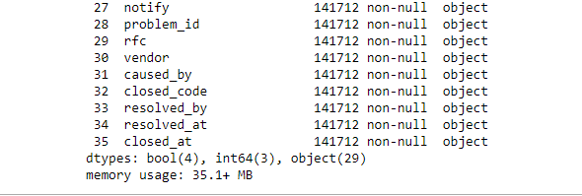
Data Information:
To find the info about the data used the code
data.info() 🡺
Here object, bool , int type of data present

Slide 9
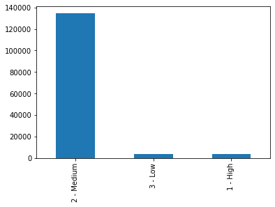
Data Visualization
Visualization of dataset :
Bar plot:
df2['impact'].value_counts().plot.bar()
From the given output it is clear that all data is concentrate in the medium values of impact ,
Therefore we can say that the data is imbalanced

Slide 10
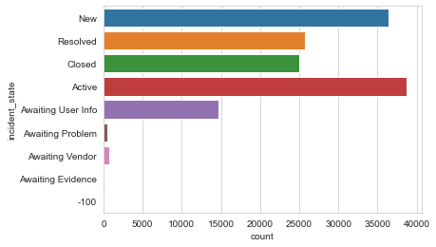
Impact on incident_state :
Incident state New and Active have high impact .
Awaiting Problem ,Awaiting Vendor and Awaiting Evidence has low impact.
Rest have medium impact.

Slide 11
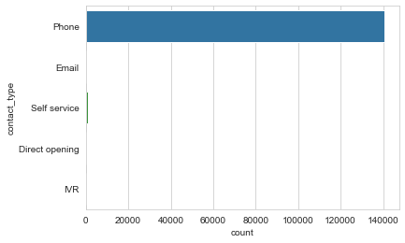
Impact on Contact_Type :
Most of the customer’s contacted via phone.

Slide 12
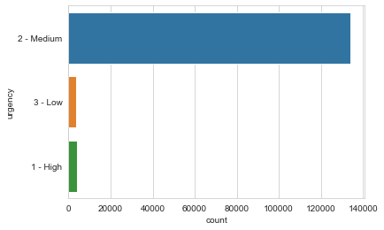
Impact on urgency :
Medium urgency have high impact.

Slide 13
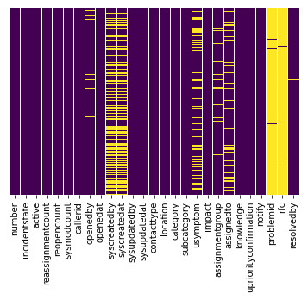
Missing Values:
Roughly 40 percent of the syscreatedby and syscreatedat data is missing.
looking at column usersymptom and assignedto less amount of data is missing nearly around 10% of data.
Looking at the problem id , rfc it looks like we are just missing too much of that data nearly 99% of data to do something useful with at a basic level.
We'll probably drop this later.
To find the missing value and visualization using heatmap :sns.heatmap(df.isnull(), cbar=False)

Slide 14
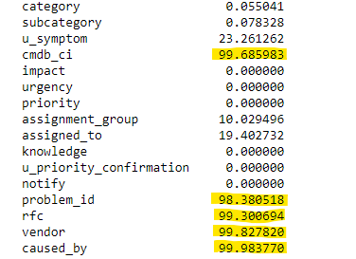
Data Cleaning:
Drop Columns:
Drop columns with more than 90% missing values
caused_by
rfc
vendor
cmdb_ci
problem_id

Slide 15
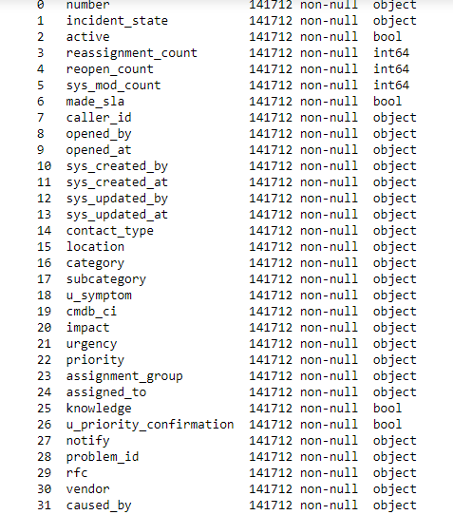
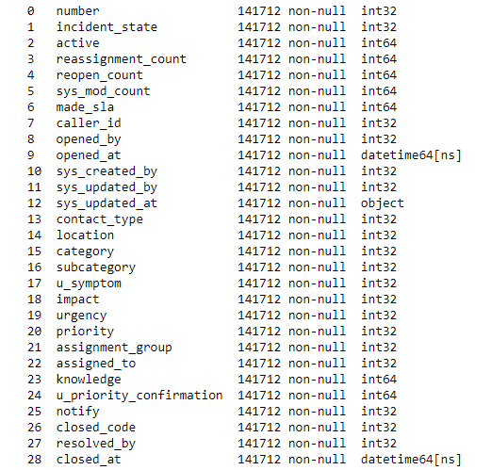
Converting Object to Integer:
OneHotLableEncoder

Slide 16
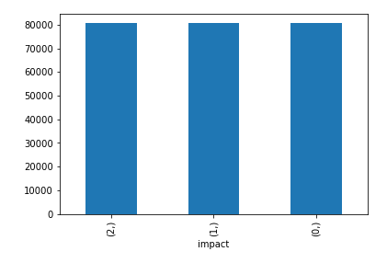
SMOTE:
SMOTE is an oversampling technique where the synthetic samples are generated for the minority class. This algorithm helps to overcome the over fitting problem posed by random oversampling
Library to install smote:
#pip install imblearn
Before SMOTE : Counter({1: 80601, 2: 2305, 0: 2121})
After SMOTE : Counter({1: 80601, 0: 80601, 2: 80601})
By applying smote, data is balanced.

Slide 17
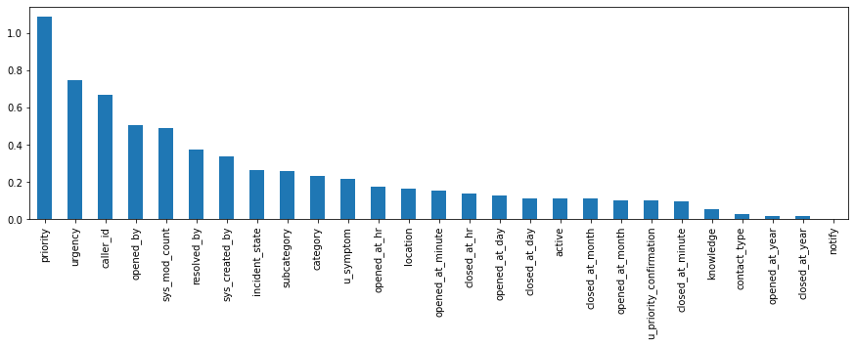
Feature Engineering:
Mutual_info_classif:
urgency 0.749340
caller_id 0.670432
opened_by 0.504009
sys_mod_count 0.488552
resolved_by 0.375694
sys_created_by 0.335643
incident_state 0.264813
subcategory 0.257093
category 0.234558
u_symptom 0.216252
opened_at_hr 0.173213
location 0.162973
opened_at_minute 0.150954
closed_at_hr 0.138136
opened_at_day 0.129194
closed_at_day 0.113606
active 0.110152
closed_at_month 0.108906
opened_at_month 0.101639
u_priority_confirmation 0.101319
closed_at_minute 0.095567
knowledge 0.052937
contact_type 0.025600
opened_at_year 0.016880
closed_at_year 0.016486
notify 0.000000

Slide 18
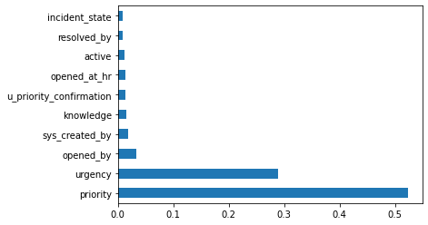
Extra_Tree Classifier:
The Extra-Tree Classifier algorithm shows the priority, urgency, opened_by, sys_created_by, Knowledge, u_priority _conformation, opened_at_hr, resolved_by ,incident_state and active these are 10 important features.

Slide 19
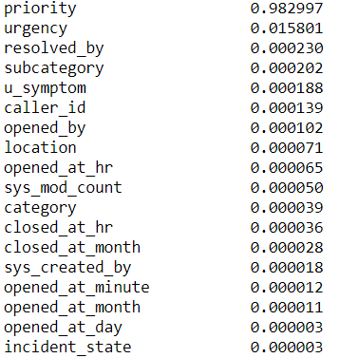
Decision tree classifier:
Using decision tree classifier we can observed that priority, urgency and active status has high importance. Some of the feature like close at year, reopen count and category has less importance

Slide 20
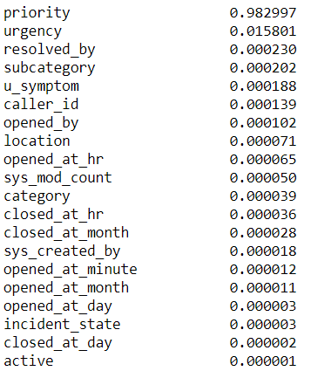
Feature selection using chi square test:
These are 10 important feature obtain by chi square test

Slide 21
Final features:
Using different feature selection techniques and domain knowledge
we consider following features for model building and which provide better accuracy for the model.
The selected features are:
'opened_by‘=User who has created the Incident
'category‘=Incident Category
Incident state =Eight levels controlling the incident management process transitions from opening until closing the case
reassignment count = of times incident has been reassigned.
'caller_id‘=Incident reporter i.e. caller
'subcategory‘=Incident Sub-Category
'u_symptom‘=Symptom/Issue type
'assigned_to‘=Incident assigned to user/person
'resolved_by‘=Incident Resolve by username/person
Priority, urgency, location and number are excluded from because the accuracy of model is equal to 1. that is model is over fitted.

Slide 22
MODEL BUILDING

Slide 23
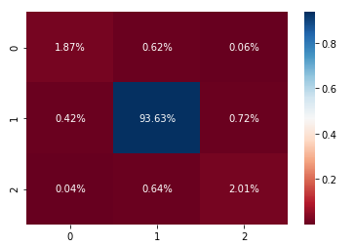
Using Random Forest Classifier :
Key Points:
Accuracy : 97.84%
Confusion Matrix : [[ 180 51 3]
[ 49 7909 59]
[ 4 44 204]]
Accuracy for training: 100%
Confusing matrix: [[ 2115 0 0]
[ 0 80534 0]
[ 0 0 2378]]
Hence, selected feature are helps to provide maximum accuracy.
Heat map of Confusion matrix for training data:
On Testing Data :
 | Precision | Recall | F1-Score | Support
High | 0.80 | 0.73 | 0.77 | 217
Medium | 0.99 | 0.99 | 0.99 | 8058
Low | 0.72 | 0.75 | 0.74 | 228

Slide 24
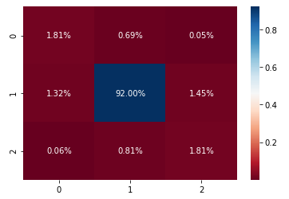
Using Decision Tree Classifier :
Key Points:
Accuracy : 95.62%
Confusion Matrix : [[ 154 59 4]
[ 112 7823 123]
[ 5 69 154]]
Accuracy for training: 100%
Confusing matrix: [[ 2115 0 0]
[ 0 80534 0]
[ 0 0 2378]]
Hence, selected feature are helps to provide maximum accuracy.
Heat map of Confusion Matrix for test data:
On Testing Data:
 | Precision | Recall | F1-Score | Support
High | 0.57 | 0.71 | 0.63 | 217
Medium | 0.98 | 0.97 | 0.98 | 8058
Low | 0.55 | 0.68 | 0.61 | 228

Slide 25
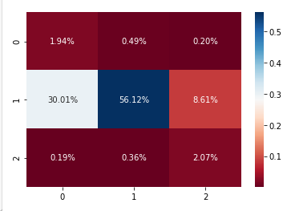
Using multilayer perceptron (MLP):
Key Points:
Accuracy : 60.13%
Confusion Matrix : [[ 165 42 17]
[ 2552 4772 732]
[ 16 31 174]]
Accuracy for training: 94.39%
Confusing matrix: [[ 0 2069 0]
[ 0 80590 0]
[ 0 2368 0]]
Hence, selected feature are helps to provide maximum accuracy.
Heat map of Confusion Matrix for test data):
On Testing Data:
 | Precision | Recall | F1-Score | Support
High | 0.06 | 0.74 | 0.11 | 224
Medium | 0.98 | 0.59 | 0.74 | 8056
Low | 0.19 | 0.79 | 0.31 | 223

Slide 26

Using xgboost Classifier:
Key Points:
Accuracy : 96.37%
Confusion Matrix : [[ 148 76 0]
[ 102 7854 100]
[ 1 29 193]]
Accuracy for training: 100%
Confusing matrix: [[ 2069 0 0]
[ 0 80590 0]
[ 0 0 2368]]
Hence, selected feature are helps to provide maximum accuracy.
Heat map of confusion matrix for test data :
On Testing data:
 | Precision | Recall | F1-Score | Support
High | 0.59 | 0.66 | 0.62 | 224
Medium | 0.99 | 0.97 | 0.98 | 8056
Low | 0.66 | 0.96 | 0.97 | 223

Slide 27
Accuracy Table:
According to the following training and testing accuracy, we consider random forest for deployment.
Model | Testing accuracy | Training accuracy
Model_rf | 97.84% | 100%
Model_dtree | 96.15% | 100%
Model_Xgb | 96.37% | 100%
Model_knn | 91.99% | 99%
Model_mlp | 60.13% | 99%
Model_gnb | 27.36% | 98.39%
Model_mnb | 21.05% | 89.47%

Slide 28
Deployment using Streamlit:
Streamlit is an open-source Python library that makes it easy to create and share beautiful, custom web apps for machine learning and data science.
In just a few minutes you can build and deploy powerful data apps - so let's get started!

Slide 29
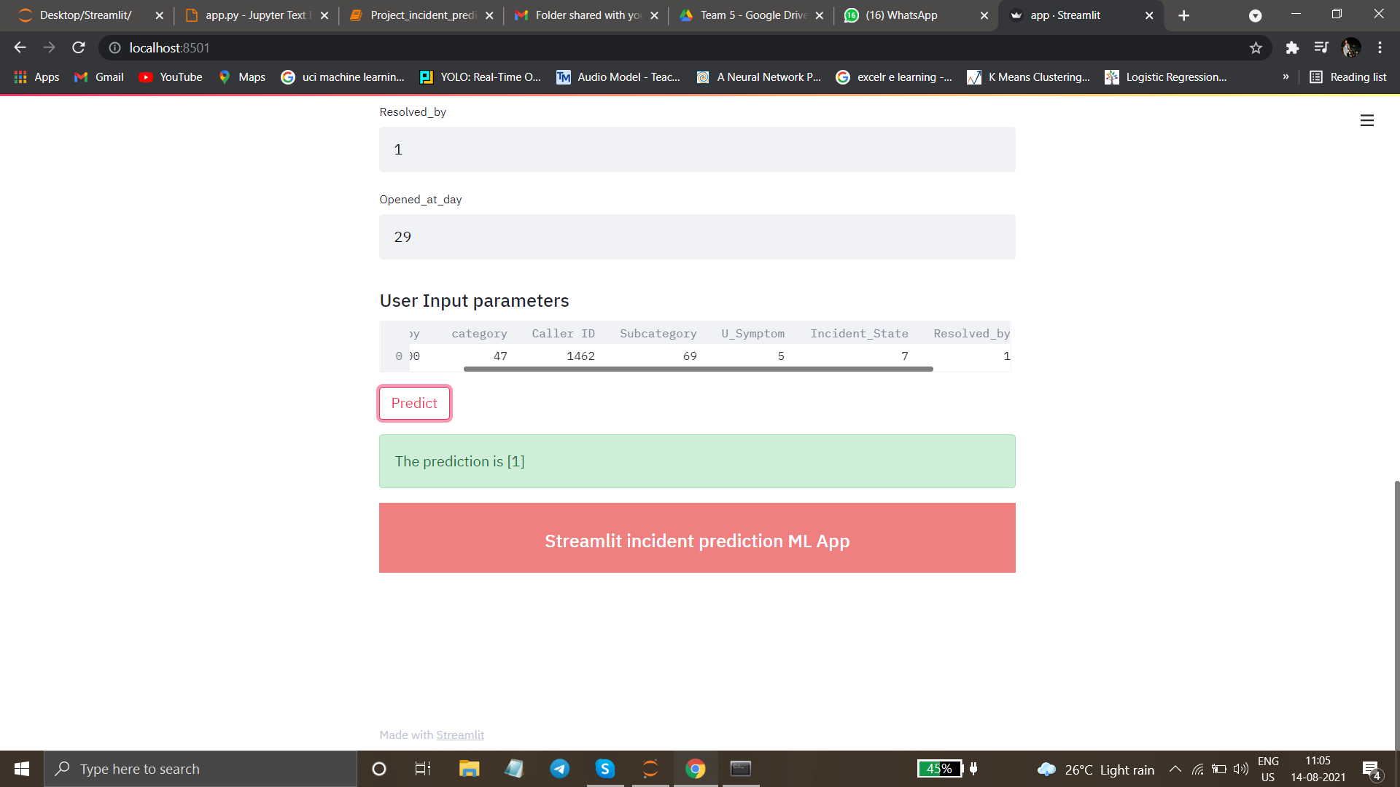
Testing Application :
Insert the values for each variable.
The app.py will predict the output.
It will give up final output in the form of [0] or [1] or [2].
Where,
0 is for Low Impact
1 is for Medium Impact
2 is for High Impact.

Slide 30
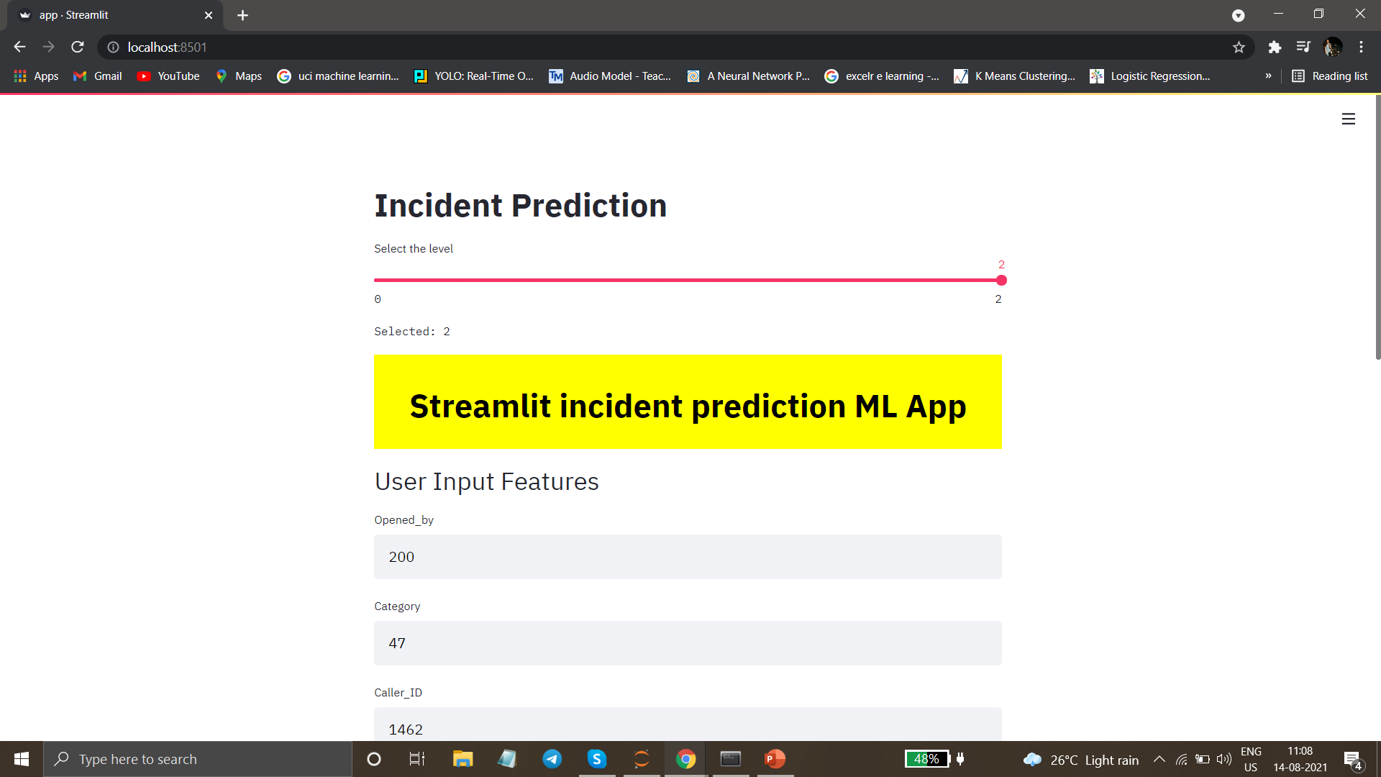
USER INTERFACE:
Local URL: http://localhost:8501
In this URL, we can input values for prediction from sidebar.
After it will go directly to Machine Learning Model.
Machine Learning model can predict the Final Result.

Slide 31
Challenges Faced:
Encoding the Variables
Balancing dataset.
Feature Selections.
Deployment Phase.

Slide 32


